Slide 1

The Battle of Neighborhoods Applied Data Science Capstone Project
Determining the distribution of Italian restaurants in Chennai to Identify the best locality to start a new one
by: Venkatesan N

Slide 2
Introduction
Background
To identify the best locality in Chennai to start a Italian cuisine restaurant.
Problem Description
Chennai is a city which home for some of the most delicious foods in southern india. A wide variety of cuisines are consumed in Chennai.
Being a metro city home to people from multiple cultures it is important to have multiple cuisines in Chennai.
Apart from the local cuisines, the most sought after cuisines are Italian and Chinese. In this project we try to identify the distribution of Italian restaurants in different localities
Interest
Those who are interested in starting an Italian restaurant in Chennai.

Slide 3
Data Acquisition and Processing
Data Terminology
In India, restaurants usually serve multiple cuisines. Also, Most of European cuisine is marked as Italian cuisine. German/ Spanish(Such as Paella) cuisines are not specifically served and they are included in Italian cuisine.
Data Sources: 3 types identified
Venue data from Foursquare.com
Names of localities are taken from https://www.mapsofindia.com/pincode/india/tamil-nadu/chennai.
Location data is taken from geocoder library from Google
Data cleaning
Foursquare takes a lat/long, a radius, and attempts to retrieve the specified number of venues covered by the circle scribed by the radius. Small radius means insufficient venues retrieved. Large radius means overlapping circles and duplicate venues
Food Venue Category- venues are classified rather arbitrary

Slide 4
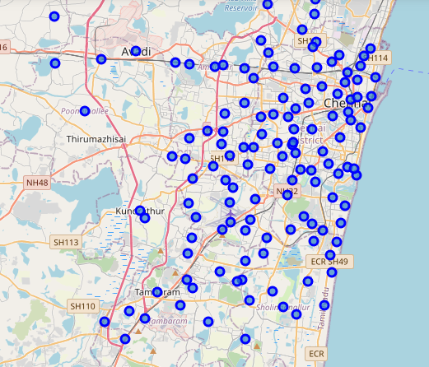
Chennai Localities map

Slide 5
The End

